Slide 1

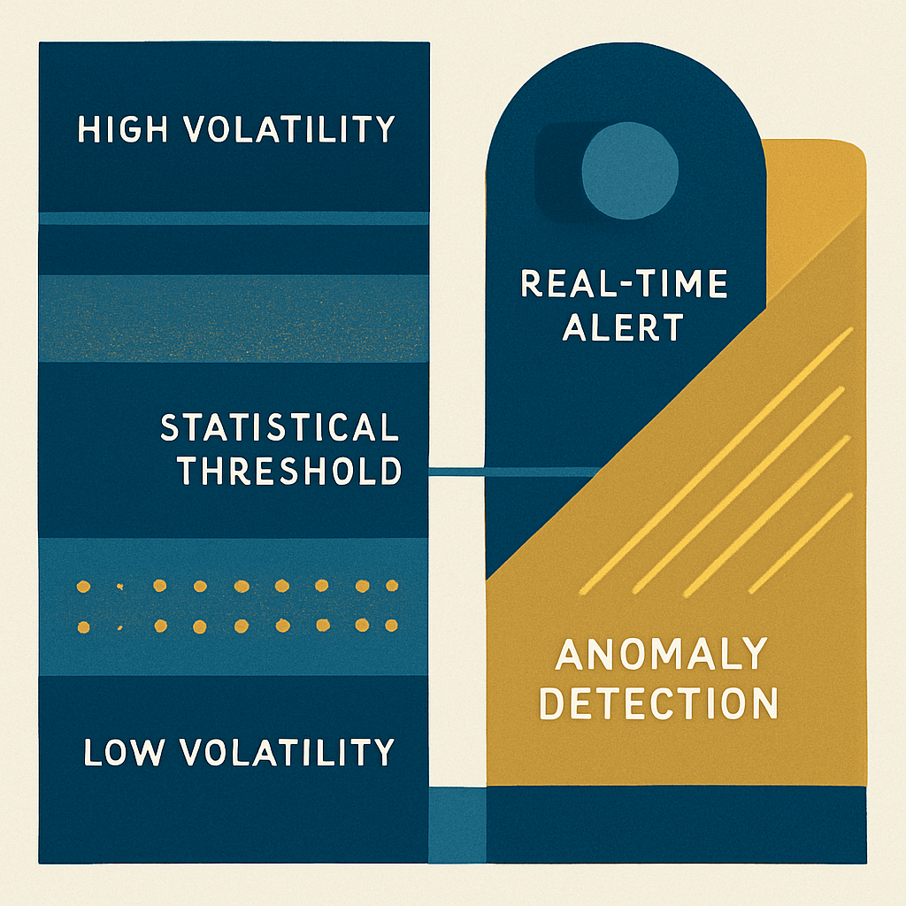
Volatility Detection in Intraday Market
B.Tech Micro Project Report | CSE (AI & DS) | 2025–26
Submitted by ,
Himanshu Mukesh Laddha (SA 208),
Jaydeep Vijay Agale (SA210),
Sai Rajendra Garudkar (SA 228)

Slide 2
PROJECT OVERVIEW
Abstract
Why It Matters
What This Project Does
These insights help traders and analysts adjust strategies, manage risk, and gain a clearer picture of market behavior. The project demonstrates how simple analytical methods can transform raw intraday data into meaningful, actionable insights for more informed trading decisions.
This project analyzes high-frequency intraday market data to identify moments when the market becomes unusually active or unstable. By calculating volatility indicators, it distinguishes between calm periods (slow price movement) and high-volatility phases (sharp price changes), reflecting real-world characteristics like volatility clustering and predictable opening/closing hour patterns.
Keywords
Intraday Trading, Market Volatility, Volatility Clustering, High-Frequency Data, Algorithmic Trading, Risk Management, Quantitative Analysis

Slide 3

CHAPTER 1
Introduction
Overview
Financial markets are highly dynamic, with prices constantly shifting due to sentiment, economic news, and trading activity. Intraday trading—buying and selling within the same trading day—is particularly sensitive to rapid price fluctuations known as volatility, which plays a crucial role in determining trading opportunities and risks.
Motivation
Traders struggle to interpret rapid market movements and identify the right time to enter or exit trades. With the growth of algorithmic trading and quantitative finance, there is a growing need for tools that process large volumes of market data and generate meaningful insights—this project aims to bridge that gap.

Slide 4
CHAPTER 1 — CONTINUED
Problem Definition, Objectives & Scope
Core Problem
Scope
Intraday markets generate large amounts of data, making it difficult to manually identify volatility patterns. The key challenge is how to accurately detect and analyze volatility in real-time or near real-time using computational methods.
Focuses on intraday market data analysis
Applies basic statistical and analytical techniques
Usable for educational purposes and as a foundation for trading strategies
Helps understand short-term market behavior
Objectives
Limitations
Analyze intraday market data and extract meaningful patterns
Develop methods for detecting volatility using statistical indicators
Identify periods of high and low volatility
Provide insights supporting trading and risk management decisions
Accuracy depends on data quality and availability
Does not guarantee profitable trading outcomes
Limited to specific indicators; may not capture all market factors
Real-time implementation may require additional optimization

Slide 5

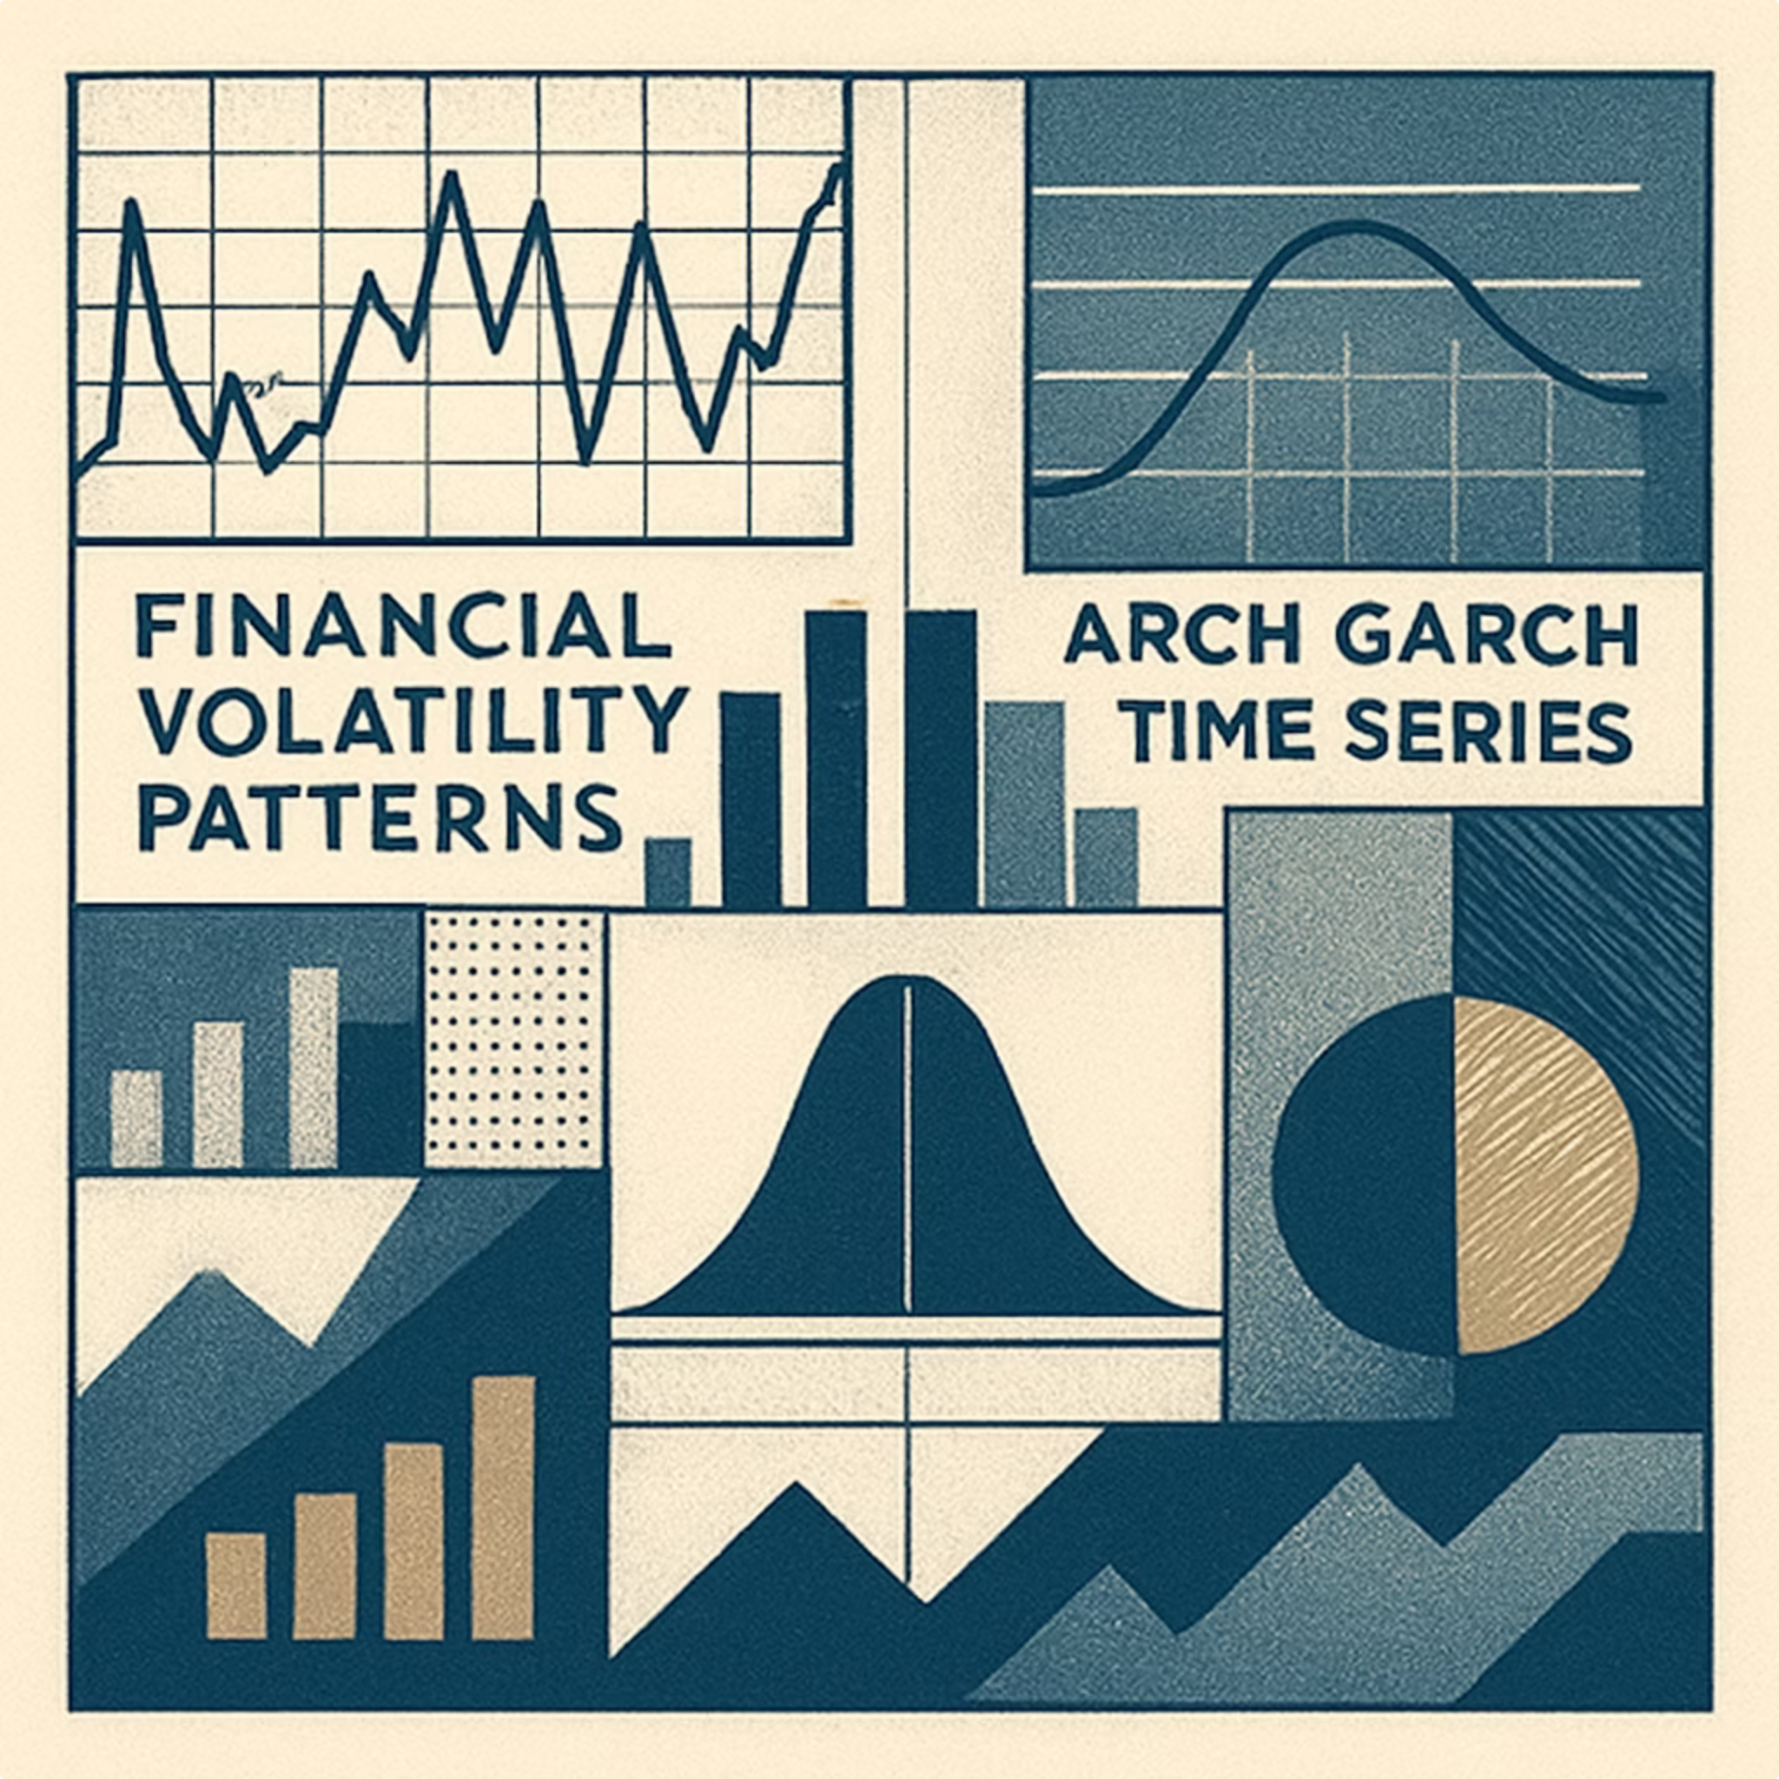
CHAPTER 2
Literature Survey
Volatility Clustering
A key observation in financial data: periods of high volatility are followed by high volatility, and low follows low—indicating that market movements are not entirely random.
ARCH & GARCH Models
Traditional models widely used to analyze and predict volatility. They effectively capture time-varying fluctuations in financial data.
Intraday Patterns
Research shows intraday data provides more detailed insights than daily data, with increased volatility during market opening and closing hours due to higher trading activity and information flow.
Modern ML Approaches
Recent methods combine statistical models with machine learning techniques—such as clustering and regime detection—to improve accuracy and identify different market conditions.

Slide 6

CHAPTER 3
Software Requirements Specification
Functional Requirements
Non-Functional Requirements
Collect and process intraday market data
Calculate volatility using statistical indicators
Classify periods as high or low volatility
Allow users to input or select datasets
Display results clearly (charts, graphs, summaries)
Support data preprocessing (cleaning, formatting)
Generate outputs to assist trading decisions
Performance: Efficient processing with minimal delay
Accuracy: Reliable, correctly calculated results
Usability: Simple, easy-to-use interface
Scalability: Handle increasing data volumes
Reliability: Consistent performance without crashes
Maintainability: Modular, easy-to-update code
Security: Basic data protection and integrity
System Requirements: Hardware: 4GB+ RAM (8GB recommended), Intel i3+, stable internet. Software: Windows/Linux/macOS, Python, Pandas, NumPy, Matplotlib/Seaborn, Scikit-learn, Jupyter/VS Code/PyCharm.

Slide 7


CHAPTER 4
System Architecture & Design
Data Collection
Volatility Calc
Ingest raw user datasets
Compute volatility metrics
Preprocessing
Analysis & Detection
Clean and format data streams
Identify anomalies and patterns
The modular architecture ensures smooth data flow between components and allows future enhancements such as real-time data integration.
Data Flow (Level 1)
UML Diagrams
User uploads or selects dataset
Data cleaning and formatting
Apply indicators and compute volatility
Detect volatility patterns
Display results graphically or textually
Use Case: User uploads dataset, processes data, analyzes volatility, views results
Class Diagram: Data Handler, Volatility Calculator, Analyzer, Visualizer
Sequence: User uploads → System preprocesses → Calculates → Analyzes → Displays

Slide 8
CHAPTER 5
Project Implementation
Module Overview
Algorithm Steps
Data Collection
Load intraday market data (price, time, volume)
Handle missing or inconsistent values
Compute price returns using percentage change
Apply rolling standard deviation over a fixed time window
Define thresholds to classify volatility as high or low
Analyze and label volatility regions
Display results through graphs or summaries
Obtains intraday market data from datasets or external sources
Preprocessing
Cleans data, removes missing values, formats dataset
Volatility Calculation
Computes volatility using standard deviation or price returns
Tools & Technologies
Python · Pandas · NumPy · Matplotlib/Seaborn · Jupyter/VS Code/PyCharm · Git/GitHub
Analysis
Identifies patterns and classifies high/low volatility zones
Visualization
Presents results via charts and graphs

Slide 9
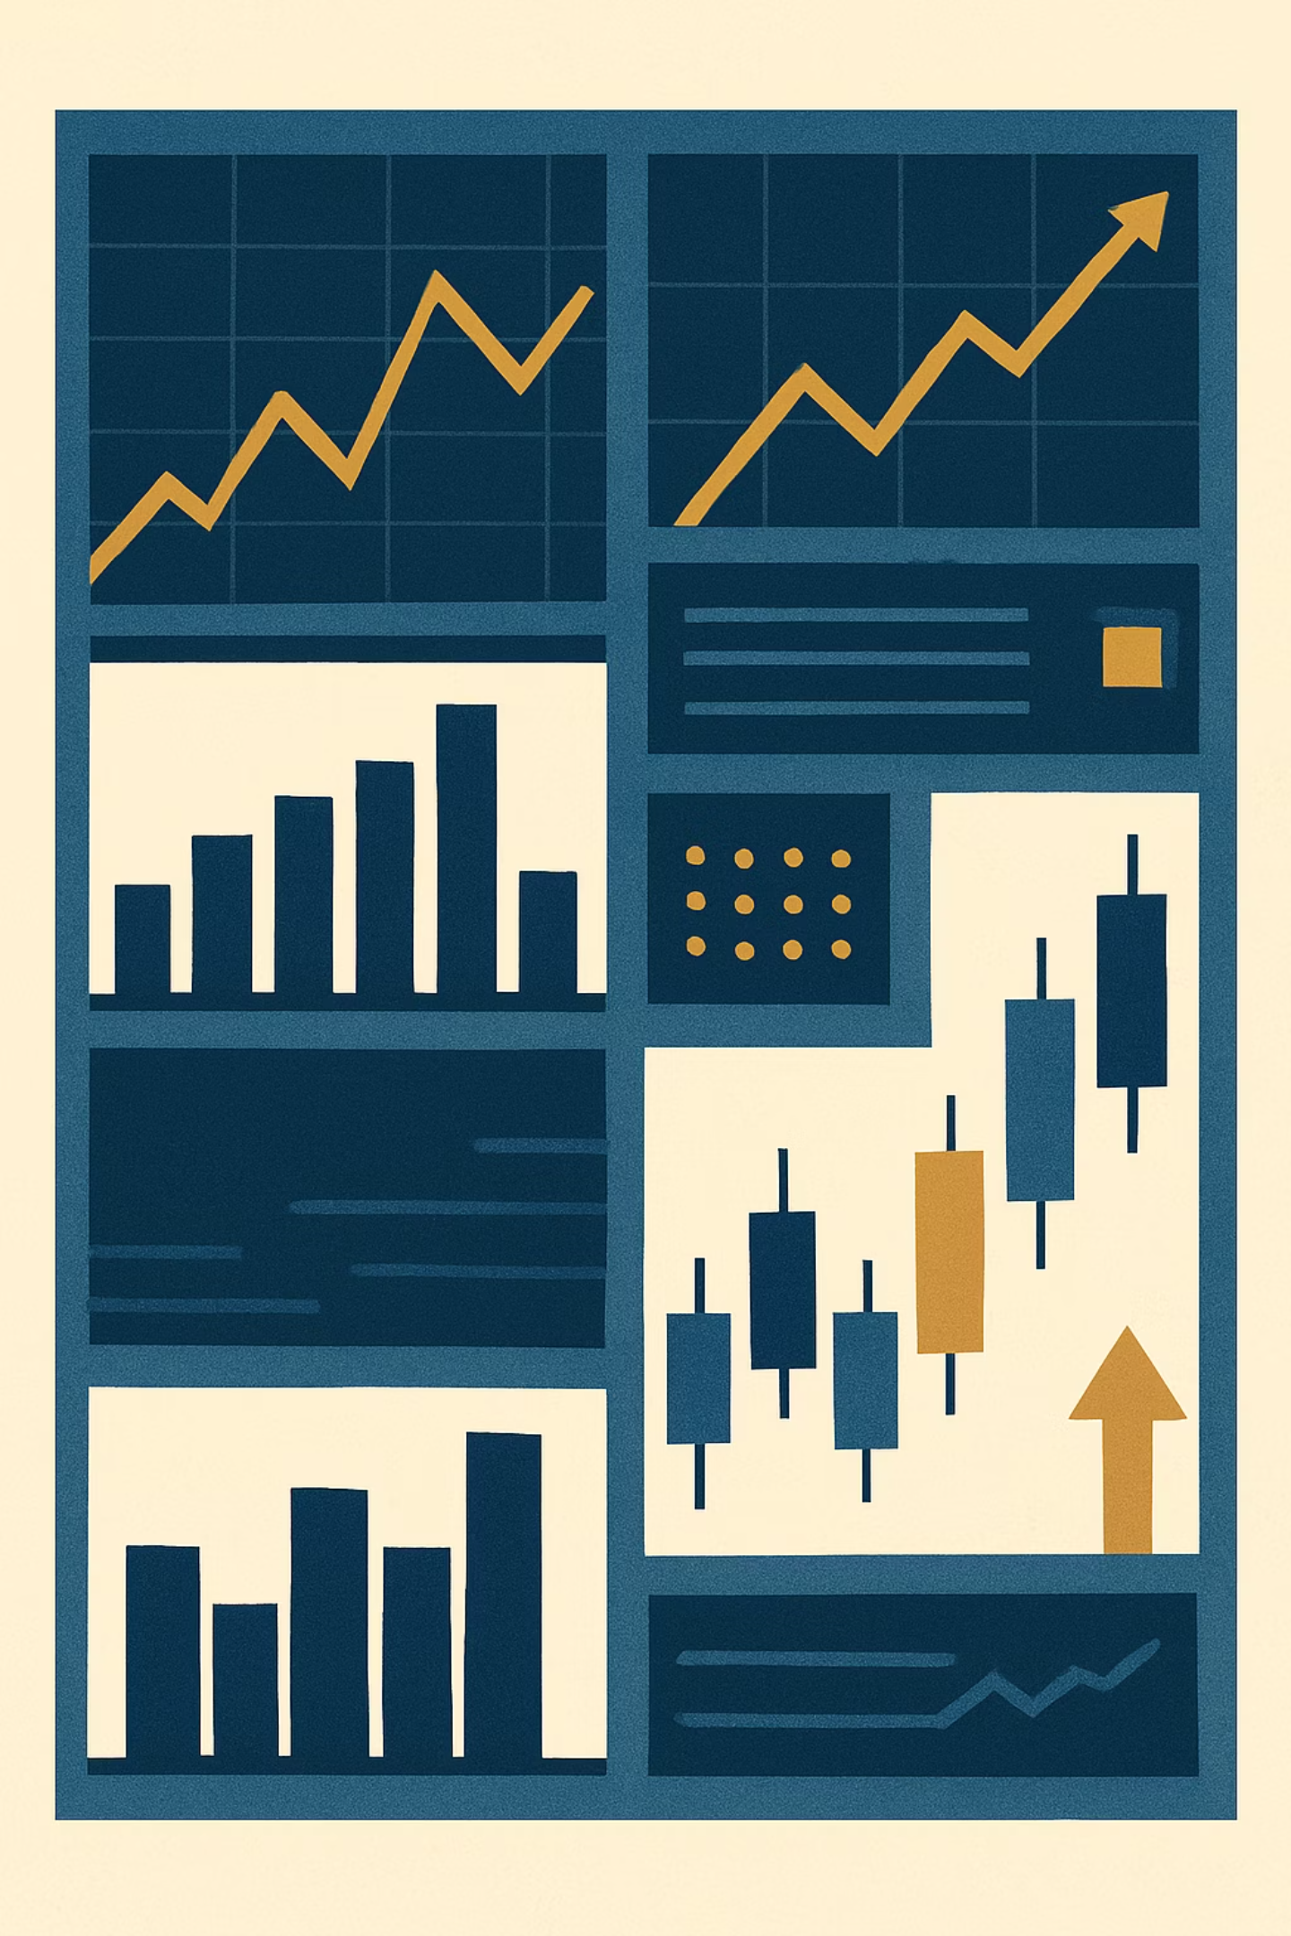
CHAPTER 6
Results & Outcomes
Volatility Detection
The project successfully detects and analyzes intraday market volatility using statistical methods, identifying periods of high and low volatility and presenting them in a clear, visual format.
Pattern Recognition
Results highlight common patterns including increased volatility during market opening and closing hours, and volatility clustering, where high-volatility periods occur consecutively.
Effective Preprocessing
The system demonstrates robust data preprocessing and handling of intraday datasets, capturing important market characteristics through systematic transformation of raw data.
Meaningful Insights
Graphical representations make it easier to understand market behavior, proving that simple analytical techniques can extract valuable information to support trading and risk management decisions.

Slide 10

CHAPTER 7
Conclusion & Future Scope
Conclusion
Future Scope
The project successfully demonstrates how intraday financial data can be analyzed to identify volatility patterns using statistical techniques such as return calculation and rolling standard deviation. It highlights key market behaviors including volatility clustering and increased activity during opening and closing hours. The system achieves its objective of transforming raw intraday data into meaningful insights, showing that even simple analytical approaches can support trading decisions and risk management.
Integration of real-time data for live volatility tracking
Advanced machine learning models for more accurate predictions
Incorporation of additional indicators and technical analysis tools
Development of a user-friendly web or mobile application interface
Extension to multiple financial markets (stocks, forex, cryptocurrencies)
Implementation of automated trading strategies based on detected volatility
References: Engle (1982) — ARCH Model; Bollerslev (1986) — GARCH; Tsay (2010) — Financial Time Series; Hull (2018) — Options & Derivatives; Pandas, NumPy, Matplotlib Documentation (2024); Research Paper: Intraday Volatility Patterns (ResearchGate); GitHub: Volatility Detection in Intraday Market

